Slide 1

Artificial Intelligence
Reinforcement Learning (Part 1)
CS 444 – Spring 2021
Dr. Kevin Molloy
Department of Computer Science
James Madison University
Much of this lecture is taken from
Dan Klein and Pieter Abbeel AI class at UC Berkeley

Slide 2
Announcements
HW 6 is will be release tomorrow. Due next Tuesday evening.
Quiz 3a will be published Tuesday after class and due before class on Thursday (March 11th) (so, March 10th in reality).

Slide 3
Reinforcement Learning
Agent
State: s
Reward: r
Actions: a
Environment
Basic idea:
Receive feedback in the form of rewards
Agent’s utility is defined by the reward function
Must (learn to) act so as to maximize expected rewards
All learning is based on observed samples of outcomes!
Figure from Berkley AI

Slide 4


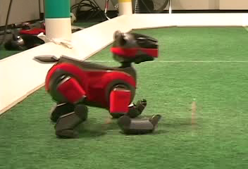
Example: Learning to Walk/Run for Soccer
Initial
A Learning Trial
After Learning [1K Trials]
Figure from Berkley AI

Slide 5
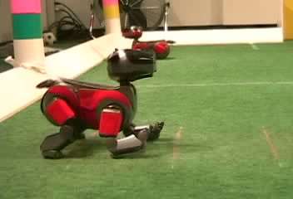
Example: Learning to Walk
[Kohl and Stone, ICRA 2004]
Initial
[Video: AIBO WALK – initial]

Slide 6

Example: Learning to Walk
Training
[Kohl and Stone, ICRA 2004]
[Video: AIBO WALK – training]

Slide 7

Example: Learning to Walk
Finished
[Kohl and Stone, ICRA 2004]
[Video: AIBO WALK – finished]

Slide 8
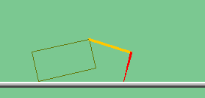
Your Next Project: The Crawler
[Demo: Crawler Bot (L10D1)]
Notes:
At times no reward accumulated at all, just sitting still

Slide 9
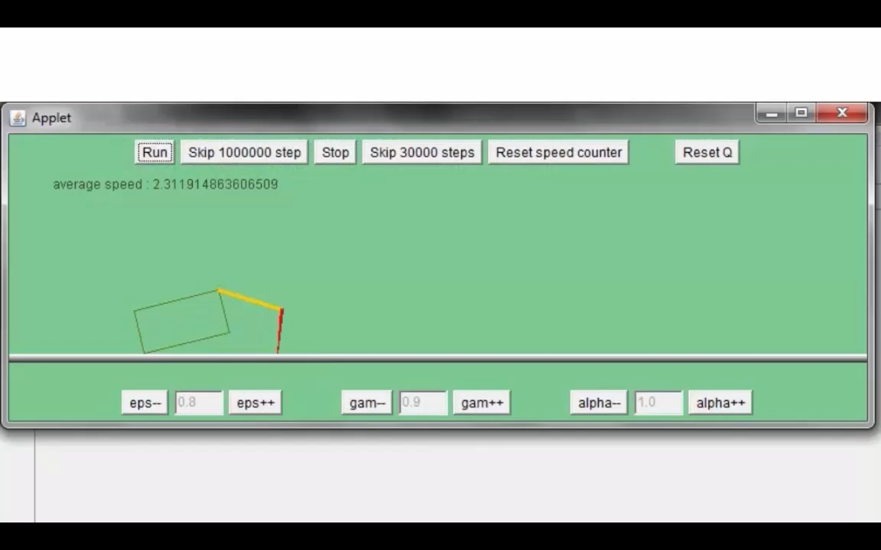
Video of the Crawler

Slide 10
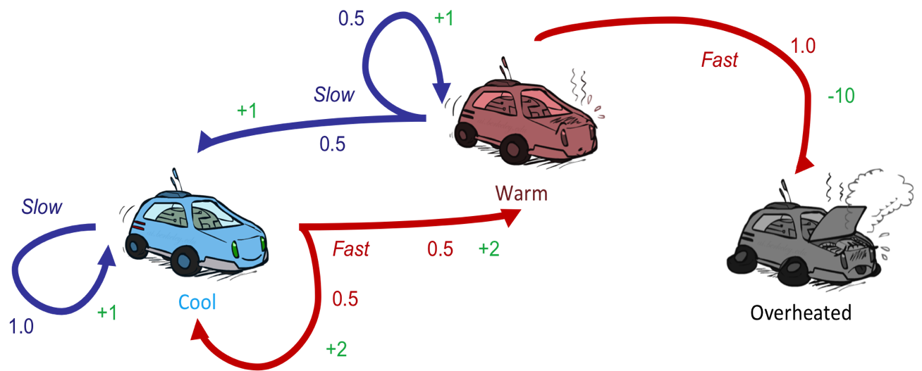
Reinforcement Learning
Still assume a Markov decision process (MDP):
A set of states s ∈ S
A set of actions (per state) A
A model T(s,a,s’)
A reward function R(s,a,s’)
Still looking for a policy π(s)
New twist: don’t know T or R
I.e. we don’t know which states are good or what the actions do
Must actually try actions and states out to learn
Figure from Berkley AI

Slide 11
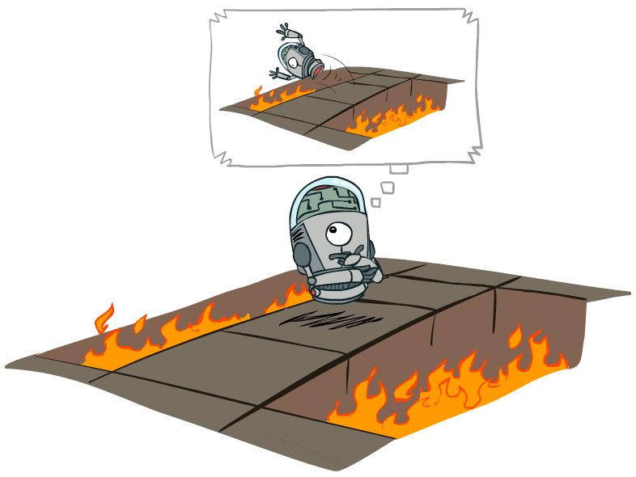
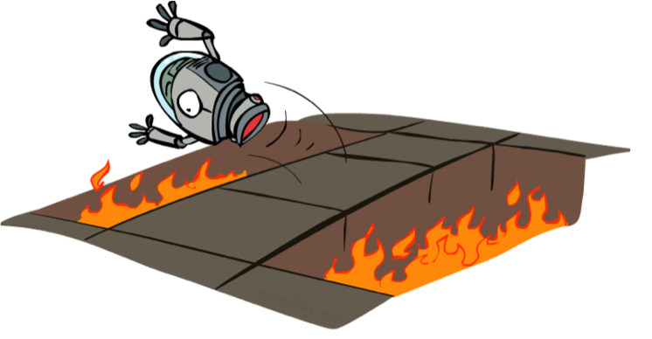
Offline (MDPs) vs. Online (RL)
Offline Solution
Online Learning
Figure from Berkley AI

Slide 12

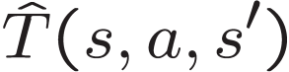

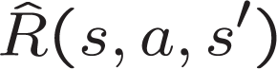
Model Learning
Model-Based Idea:
Learn an approximate model based on experiences
Solve for values as if the learned model were correct
Step 1: Learn empirical MDP model
Count outcomes s’ for each s, a
Normalize to give an estimate of
Discover each when we experience (s, a, s’)
Step 2: Solve the learned MDP
For example, use value iteration, as before
Figure from Berkley AI

Slide 13
Example: Model-Based Learning
Input Policy π
Observed Episodes (Training)
Learned Model
Episode 1
Episode 2
T(s,a,s’).
T(B, east, C) = 1.00
T(C, east, D) = 0.75
T(C, east, A) = 0.25
…
R(s,a,s’).
R(B, east, C) = -1
R(C, east, D) = -1
R(D, exit, x) = +10
…
 | A
B | C | D
 | E
B, east, C, -1
C, east, D, -1
D, exit, x, +10
B, east, C, -1
C, east, D, -1
D, exit, x, +10
Episode 3
Episode 4
E, north, C, -1
C, east, D, -1
D, exit, x, +10
E, north, C, -1
C, east, A, -1
A, exit, x, -10
Assume: γ = 1
Figure from Berkley AI

Slide 14
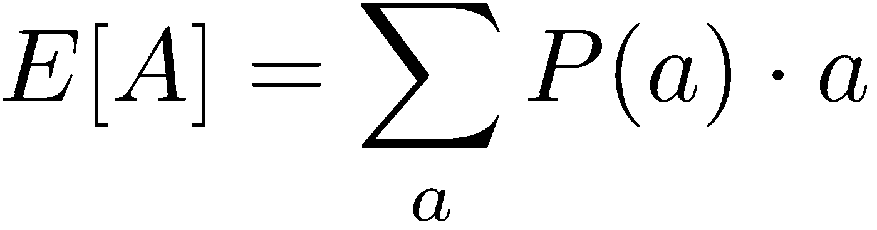
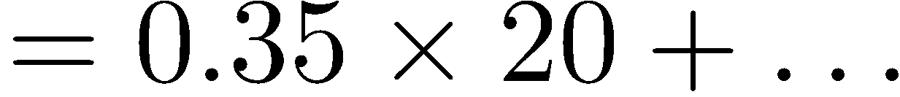
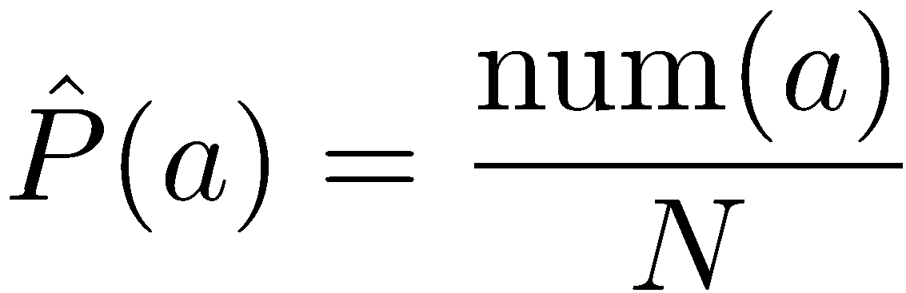
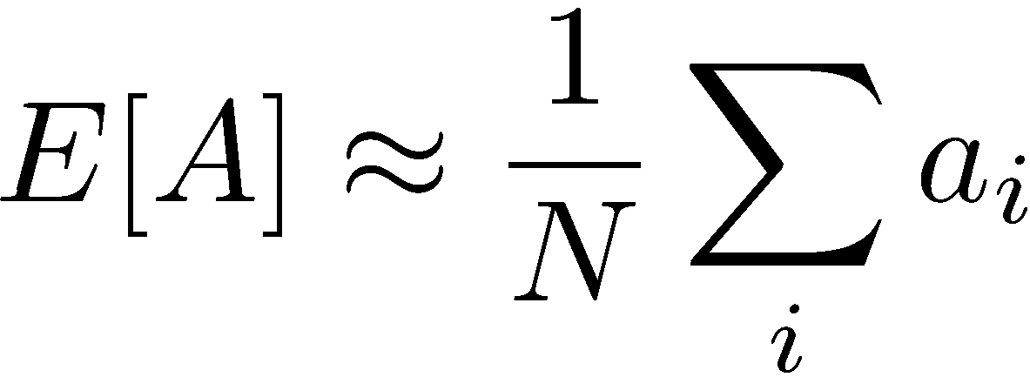
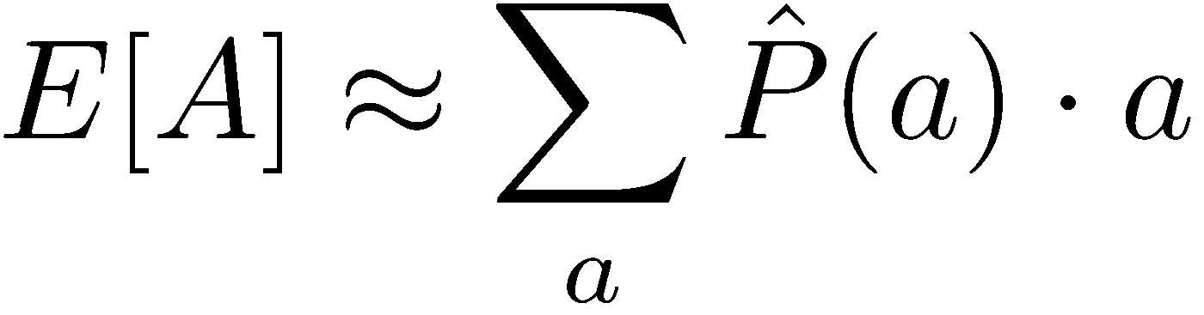
Example: Expected Age
Goal: Compute expected age of cs444 students
Known P(A)
Without P(A), instead collect samples [a₁, a₂, … a_{N}]
Unknown P(A): “Model Based”
Unknown P(A): “Model Free”
Why does this work? Because eventually you learn the right model.
Why does this work? Because samples appear with the right frequencies.
Figure from Berkley AI

Slide 15

Model-Free Learning
Figure from Berkley AI

Slide 16
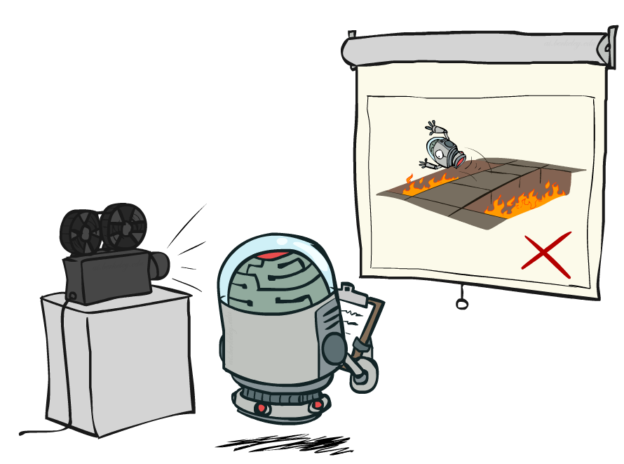
Passive Reinforcement Learning
Figure from Berkley AI

Slide 17

Passive Reinforcement Learning
Simplified task: policy evaluation
Input: a fixed policy π(s)
You don’t know the transitions T(s,a,s’)
You don’t know the rewards R(s,a,s’)
Goal: learn the state values
In this case:
Learner is “along for the ride”
No choice about what actions to take
Just execute the policy and learn from experience
This is NOT offline planning! You actually take actions in the world.
Figure from Berkley AI

Slide 18
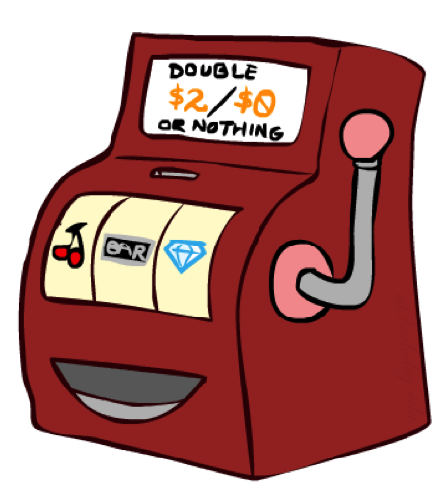
Direct Evaluation
Goal: Compute values for each state under π
Idea: Average together observed sample values
Act according to π
Every time you visit a state, write down what the sum of discounted rewards turned out to be
Average those samples
This is called direct evaluation
Figure from Berkley AI

Slide 19
Example: Direct Evaluation
Input Policy π
Observed Episodes (Training)
Output Values
Episode 1
Episode 2
 | A
B | C | D
 | E
 | A
B | C | D
 | E
B, east, C, -1
C, east, D, -1
D, exit, x, +10
B, east, C, -1
C, east, D, -1
D, exit, x, +10
-10
+8
+4
+10
Episode 3
Episode 4
-2
E, north, C, -1
C, east, D, -1
D, exit, x, +10
E, north, C, -1
C, east, A, -1
A, exit, x, -10
Assume: γ = 1
Figure from Berkley AI

Slide 20
Problems with Direct Evaluation
What’s good about direct evaluation?
It’s easy to understand
It doesn’t require any knowledge of T, R
It eventually computes the correct average values, using just sample transitions
What bad about it?
It wastes information about state connections
Each state must be learned separately
So, it takes a long time to learn
Output Values
 | A
B | C | D
 | E
-10
+8
+4
+10
-2
If B and E both go to C under this policy, how can their values be different?
Figure from Berkley AI

Slide 21

Why Not Use Policy Evaluation?
s
Simplified Bellman updates calculate V for a fixed policy:
Each round, replace V with a one-step-look-ahead layer over V
This approach fully exploited the connections between the states
Unfortunately, we need T and R to do it!
Key question: how can we do this update to V without knowing T and R?
In other words, how to we take a weighted average without knowing the weights?
π(s)
s, π(s)
s, π(s),s’
s’
Figure from Berkley AI

Slide 22
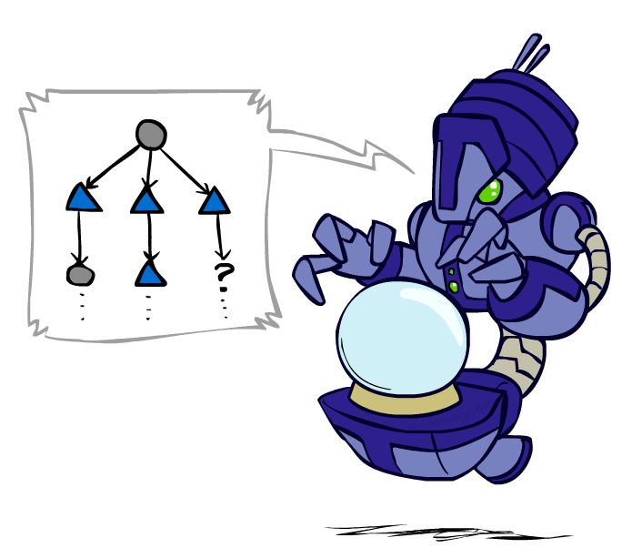
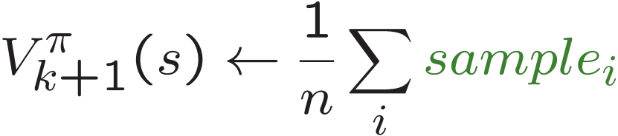
Sample-based Policy Evaluation
s
π(s)
s, π(s)
s, π(s),s’
s₁'
s₂'
s'
s₃'
Almost! But we can’t rewind time to get sample after sample from state s.
Figure from Berkley AI

Slide 23
Temporal Difference Learning
Big idea: learn from every experience!
Update V(s) each time we experience a transition (s, a, s’, r)
Likely outcomes s’ will contribute updates more often
Temporal difference learning of values
Policy still fixed, still doing evaluation!
Move values toward value of whatever successor occurs: running average
s
π(s)
s, π(s)
s’
Sample of V(s):
Update to V(s):
Same update:
Figure from Berkley AI

Slide 24
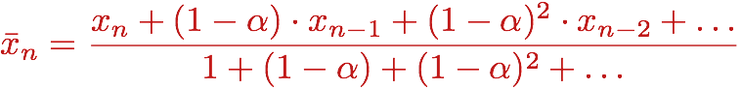
Exponential Moving Average
Exponential moving average
The running interpolation update:
Makes recent samples more important:
Forgets about the past (distant past values were wrong anyway)
Decreasing learning rate (alpha) can give converging averages
Figure from Berkley AI

Slide 25
Example: Temporal Difference Learning
States
Observed Transitions
B, east, C, -2
C, east, D, -2
 | A
B | C | D
 | E
 | 0
0 | 0 | 8
 | 0
 | 0
-1 | 0 | 8
 | 0
 | 0
-1 | 3 | 8
 | 0
Assume: γ = 1, α = 1/2
Figure from Berkley AI

Slide 26
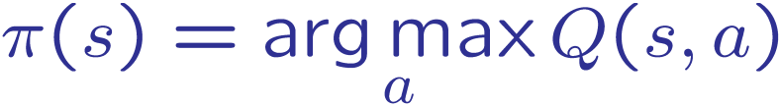
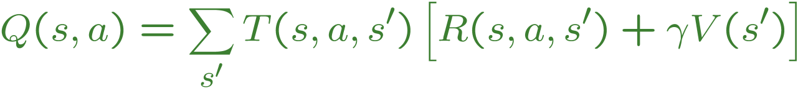
Problems with TD Value Learning
TD value leaning is a model-free way to do policy evaluation, mimicking Bellman updates with running sample averages
However, if we want to turn values into a (new) policy, we’re sunk:
Idea: learn Q-values, not values
Makes action selection model-free too!
s
a
s, a
s,a,s’
s’
Figure from Berkley AI

Slide 27
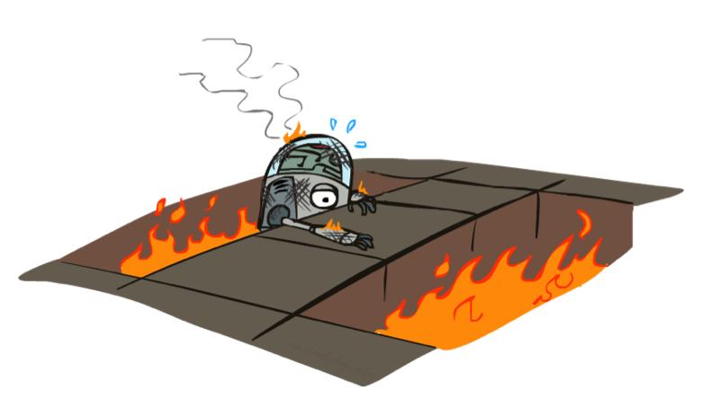
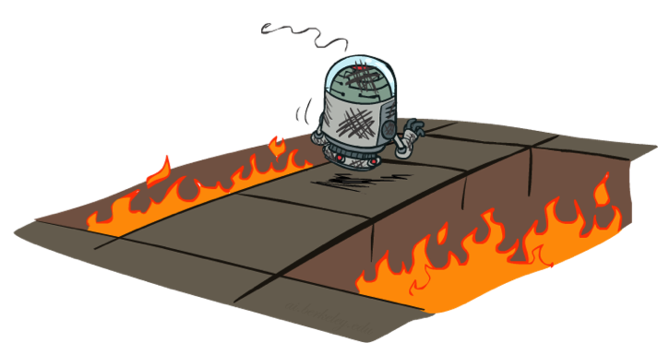
Active Reinforcement Learning
Figure from Berkley AI

Slide 28
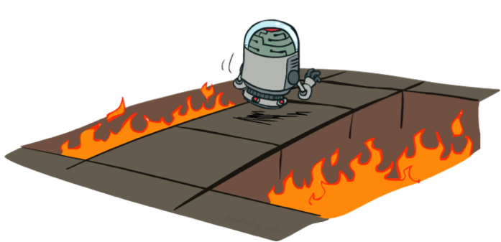
Active Reinforcement Learning
Full reinforcement learning: optimal policies (like value iteration)
You don’t know the transitions T(s,a,s’)
You don’t know the rewards R(s,a,s’)
You choose the actions now
Goal: learn the optimal policy / values
In this case:
Learner makes choices!
Fundamental tradeoff: exploration vs. exploitation
This is NOT offline planning! You actually take actions in the world and find out what happens…
Figure from Berkley AI

Slide 29
Detour: Q-Value Iteration
Value iteration: find successive (depth-limited) values
Start with V₀(s) = 0, which we know is right
Given V_{k}, calculate the depth k+1 values for all states:
But Q-values are more useful, so compute them instead
Start with Q₀(s,a) = 0, which we know is right
Given Q_{k}, calculate the depth k+1 q-values for all q-states:
Figure from Berkley AI

Slide 30
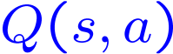
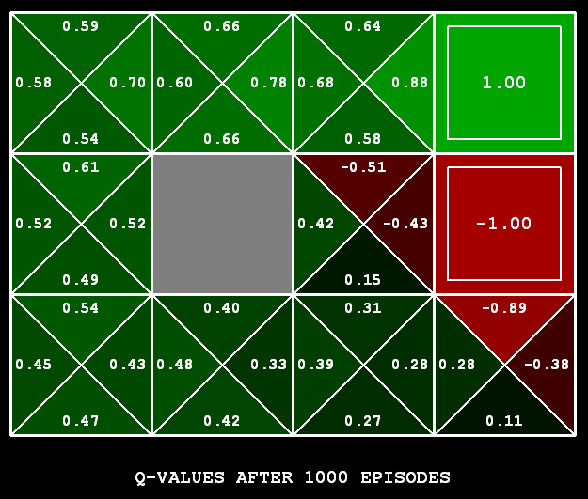
Q-Learning
Q-Learning: sample-based Q-value iteration
Learn Q(s,a) values as you go
Receive a sample (s,a,s’,r)
Consider your old estimate:
Consider your new sample estimate:
Incorporate the new estimate into a running average:
[Demo: Q-learning – gridworld (L10D2)]
[Demo: Q-learning – crawler (L10D3)]
Figure from Berkley AI

Slide 31
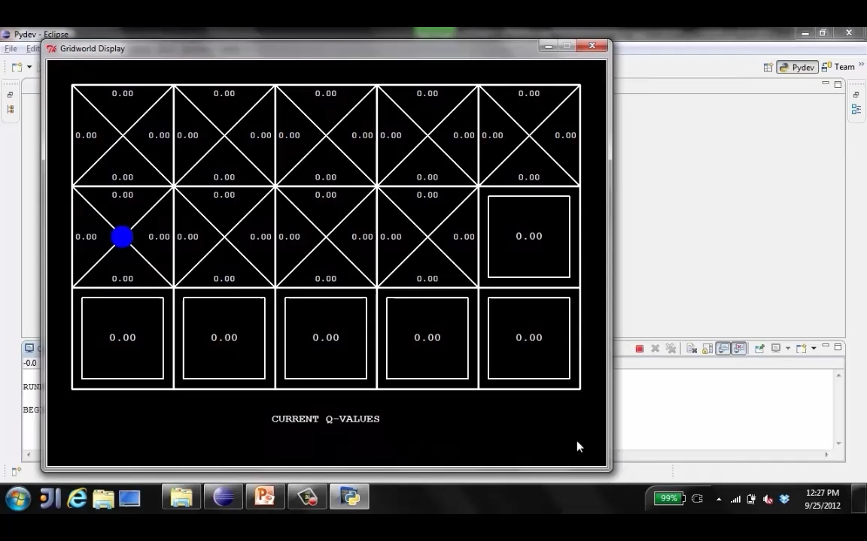
Demo of Q-Learning Gridworld
Figure from Berkley AI

Slide 32
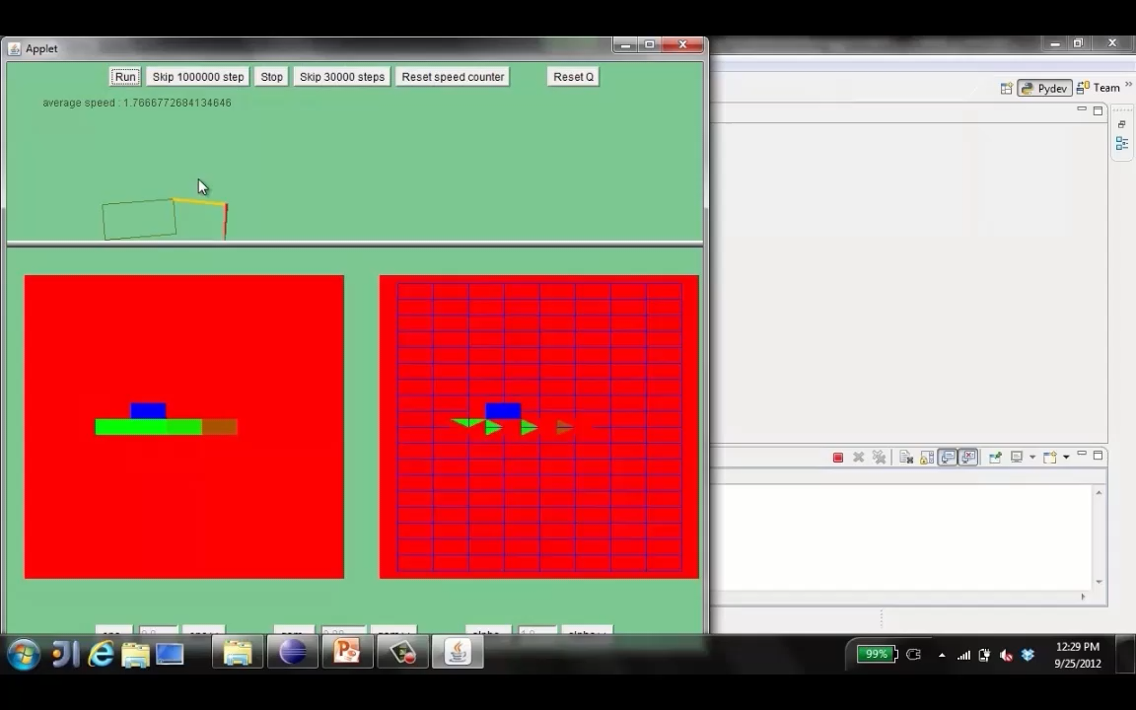
Demo of Q-Learning -- Crawler
Figure from Berkley AI

Slide 33

Q-Learning Properties
Amazing result: Q-learning converges to optimal policy -- even if you’re acting suboptimally!
This is called off-policy learning
Caveats:
You have to explore enough
You have to eventually make the learning rate
small enough
… but not decrease it too quickly
Basically, in the limit, it doesn’t matter how you select actions (!)
Figure from Berkley AI

